Slide 1
Online TULIP
Special Event Program

Slide 2
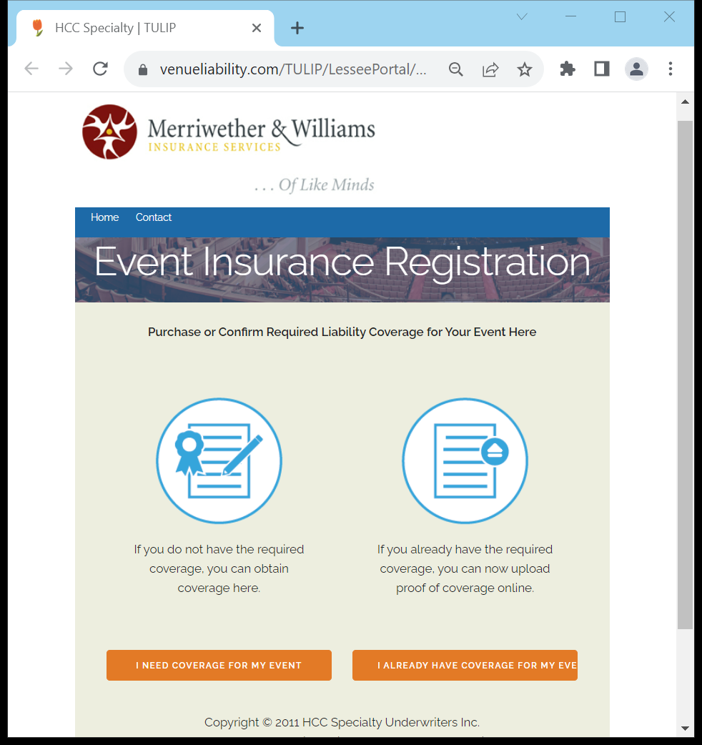
How to begin
The Special Event Program for PERMA has transitioned onto an automated quoting system. All applicants seeking insurance coverage for a special event should be directed to the PERMA Online TULIP portal.
https://venueliability.com/PERMA
Once on the website, the applicant must click on “I NEED COVERAGE FOR MY EVENT” to get started.

Slide 3
Event location
Applicant will need to select the event location based on their event, including city and venue.

Slide 4
Event location
As of now PERMA cities include the following venues:
City of Banning
Repplier Park Aquatic Center
Banning Senior Citizens Center
Banning Community Center
Lions Park
Richard Sanchez Park
Dysart Equestrian Park
Repplier Park
Roosevelt Williams Park
Sylvan Park
City of Perris
Bob Glass Gymnasium
Statler Youth Center
Perris Senior Center
Banta Beatty Park
Bob Long Park
Copper Creek Park
Downtown Pocket Park
El Nido Pocket Park
Enchanted Hills Park
Fletcher Park
Foss Field Park
Frank Eaton Memorial Park
Geotz Park
Liberty Park
Howard Schlundt Park
Linear Park May Ranch Park
May Ranch Pocket Park
Mercado Park
Metz Park Perris, CA 92570
Monument Ranch Park
Morgan Park
Paragon Park
Partriot Park Sports Complex
Rotary Park
Russell Stewart Park
Skydive Baseball Park

Slide 5
Event Date(s)
The next step is selecting your event dates.
Depending on your event and how many days it will be, you are able to select multiple dates at one time.
E.g - For a birthday party which is typically one day, you will select just the day of your event.
E.g – For a meeting being held every Sunday for a month, you are able to select multiple Sundays

Slide 6
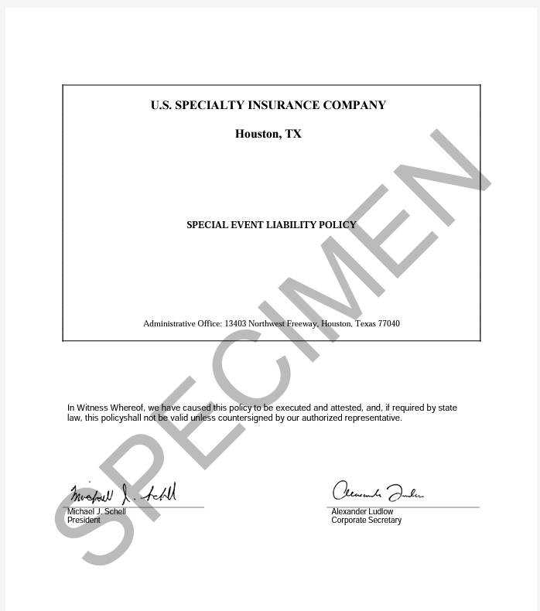
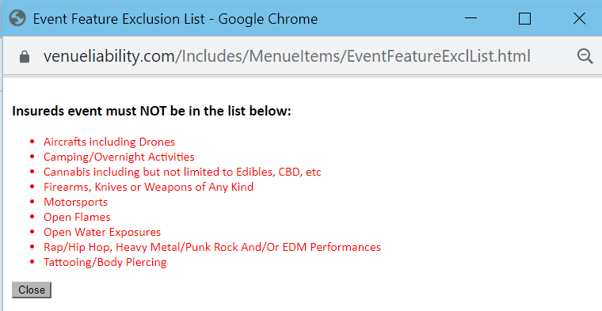
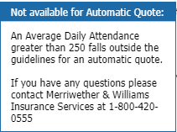
Event Details
Step 3 will consist of your event. You will provide details regarding the following:
Event name
Event type
If event has been held before
Will alcohol be sold
Attendance
IMPORTANT!
Event Exclusion List and Sample Policy must be clicked into and viewed in order to be able to select “yes or no” and to be allowed to move onto the next page.
Please note: If your event type is not listed or daily attendance exceeds automatic quoting guidelines, please contact Merriwether & Williams at 1-800-420-0555

Slide 7
Price summary
Reviewing policy information
Under “My Event” you are able to review your event information including premium total, location, venue and event details.
It is important to make sure all this information is correct before continuing to the next page, as this is what will appear on the Certificate of Insurance.
The left-hand side will include premium breakdown and the limits included in the policy.

Slide 8
Applicant Info
Insured name should be the name as you would like to appear on the Certificate of Insurance.
The remaining information on this page will be the applicant information, including name, address, phone number and email where you would like to receive proof of your insurance once it has been purchased.

Slide 9
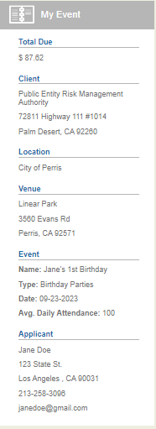
Payment Info
This is the final step before binding coverage.
Enter CC information and the corresponding billing address.
You are able to review your event information one last time before completing your purchase.

Slide 10
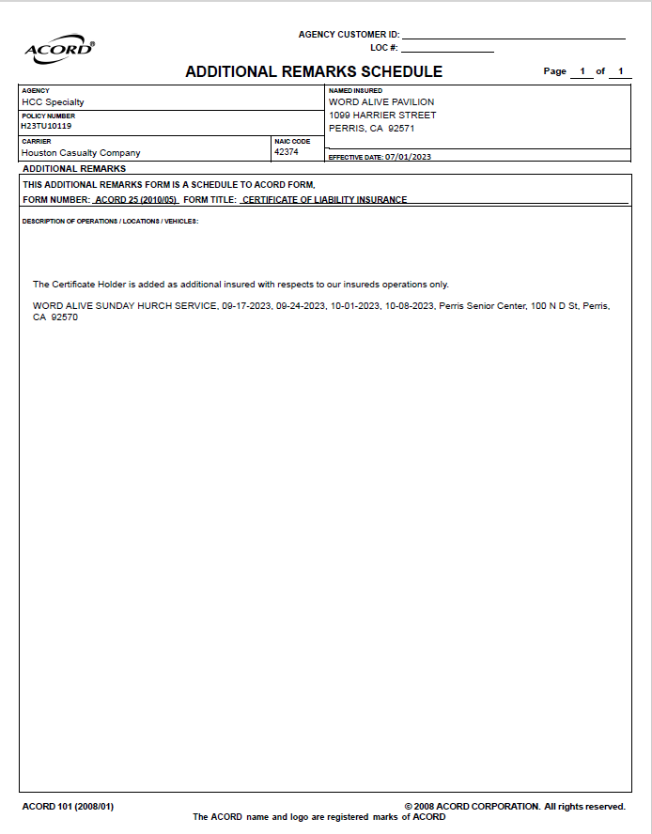
Certificate of Insurance
Once payment is successful, the insured should receive an email with a copy of their certificate of insurance.
All event details will be on the Additional Remarks Schedule under description of operations.
This includes event name, dates of event and venue of choice.
It is the insured’s responsibility to present the COI to their point of contact at the venue.

Slide 11
Questions?

